Slide 2
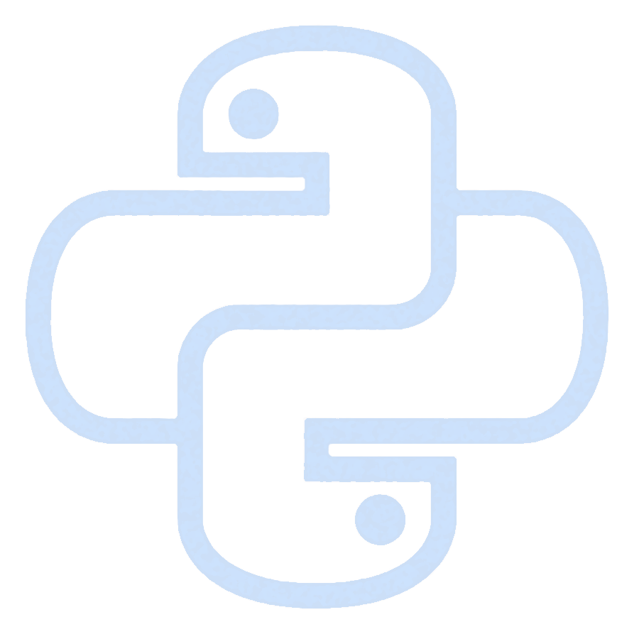
Python Integration of the Sb2Se3 Optical Switching Experiment
Daniel-Iosif Trubacs, Professor Otto Muskens
14 August 2023

Slide 3
Technical Setup
BNC
Dig. Mod.
PUMP
OPT
PROBE
BNC – BK Precision 4063B. Controlled trough python.
PUMP – 480 nm laser. Controlled by BNC.
OPT – Optical setup. Different optical elements (black box).
PROBE – 980 nm laser. Always constant power.
XMOT and YMOT - Thorlabs KDC101 Brushed Motor Controllers. Controlled through Python.
XY STAGE. Controlled by motors.
480 nm
980 nm
Ana. Mod.
XMOT
XY STAGE
YMOT

Slide 4
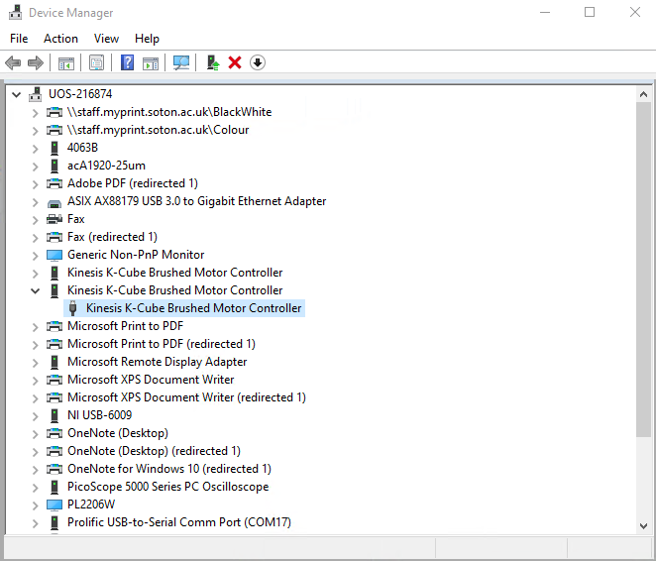
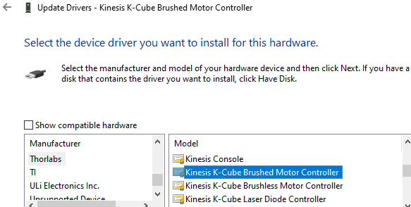
Software Requirements
All the code is written in Python and maintained on the GitHub repository: pyphotonics.
To be able to use the code, you have to first install git: git-scm
Connect all the instruments to the computer. Install the latest drivers for Thorlabs KDC101 APT Drivers.
Updated the devices corresponding to the KDC101 motors with the Thorlabs driver via Device Manager.

Slide 5
Programming Setup
Create a conda environment with Python 3.11
Activate the environment and install all the packages in requirements.txt via pip. Open an IDE, create a project and choose pyphotonics as the interpreter. Open cmd, navigate to the directory where the project is located and initialize a git repository.
Add the pyphotonics GitHub repo as the remote origin.
Pull the latest version of the code.
conda create --name pyphotonics python=3.11
git init --initial-branch=main
git remote add origin https://github.com/dntrubacs/pyphotonics.git
git pull origin main

Slide 6
Code Structure
Sb2Sb3ExperimentControl
Controls the main experiment.
Writes on a pixel by sending a short pulse.
Moves the motors to make a pixel map.
BKCom
KDC101Com
Controls the BNC.
Sends Analog and Digital Modulation.
Controls the motors.
Move the motor to a given position.

